Slide 1
NE 763: Advanced Reactor Materials
Fall 2026
Dr. Benjamin Beeler

Slide 2
Last Time
Graphite has lots of texture and porosity
Thermal stress cracks form…
anisotropic CTE, Mrozowski cracks
Radiation induced shrinkage and turnaround…
interstitials cause c expansion and a contraction, vacancies cause a contraction
aligned porosity closes due to lattice expansion, results in net contraction
once porosity is closed, leads to net expansion (faster expansion in c than contraction in a)
Graphite thermal conductivity approximately saturates with dose, becomes temperature-independent
Irradiation creep is fundamentally important, allows stress relaxation of graphite
TRISO failure modes:
Overpressure, IPyC cracking, IPyC and SiC debonding, Kernel migration, etc.

Slide 3
TRISO Fuel Performance

Slide 4
TRISO Fuel Performance
Fuel performance models need to be able to account for numerous inter-related phenomena that affect temperatures, stresses, and failure of the material systems
Must be multiphysics, incorporating thermodynamics, chemistry, kinetics, microstructure, mechanics, neutronics, etc., whether directly or indirectly accounted for
Solid fission product swelling
Gaseous fission product swelling
Densification
Thermal conductivity
Fission gas release
CO production
Oxygen transport
PyC layer dimensional change
Kernel migration
SiC failure
Fission product attack

Slide 5
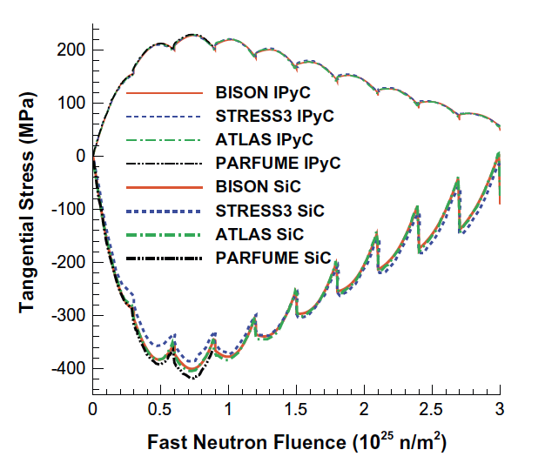
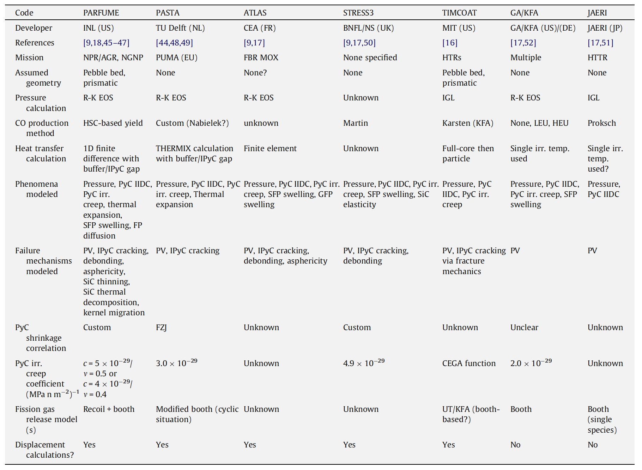
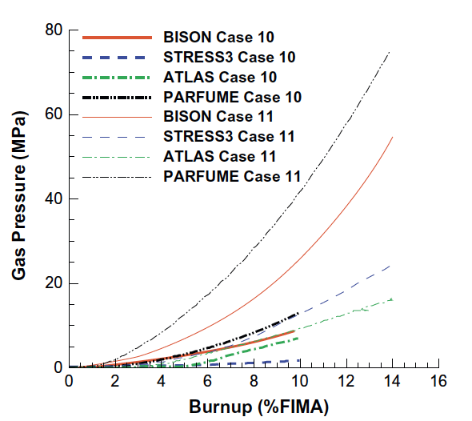
Fuel Performance Codes

Slide 6
SiC Failure
The dominant 1D failure mechanism for TRISO fuel particles involves pressure vessel failure, where the SiC layer develops a through-thickness crack resulting from a tensile stress that exceeds the fracture strength of the material
Modern approaches to pressure vessel (SiC) failure explicitly calculate separate stresses and through-layer crack probabilities for the SiC layer and each PyC layer

Slide 7
TRISO Stresses
The irradiation causes the kernel to swell and the buffer layer to shrink, thereby modifying the internal void volume available to the fission and reaction gases
The porosity of the buffer leads to the gas pressure being the only force on the load-bearing layers
If the IPyC and OPyC were absent, the gases produced in the fission process would simply stress the SiC layer and, if the pressure were high enough, cause it to fail
However, these tangential stresses are reduced by the presence of the two PyC layers because; under unrestrained conditions they would shrink during irradiation

Slide 8
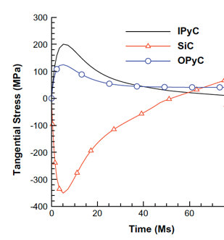
TRISO Stresses
PyC shrinkage will be largely restrained by the SiC layer, and tangential stresses will be generated in both PyC layers, with radial (inward) acting forces imposed on the two surfaces of the SiC layer
In practice, these tangential stresses in the two PyC layers will attain a quasi-equilibrium stress state because their shrinkage is counter-balanced by irradiation creep
The SiC elastic modulus is at least an order of magnitude greater than that of PyC and thus, the dimensional changes and creep strains of SiC are comparatively much smaller than for PyC

Slide 9

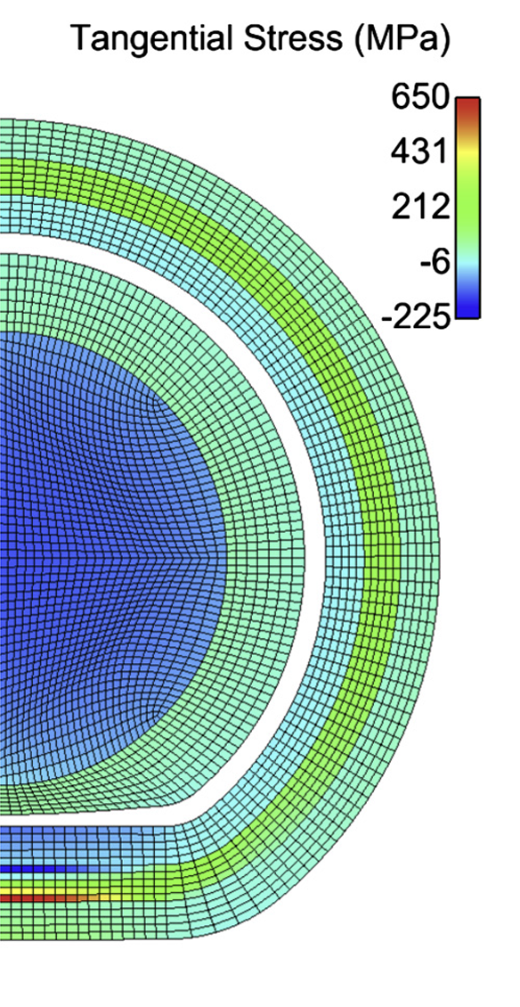
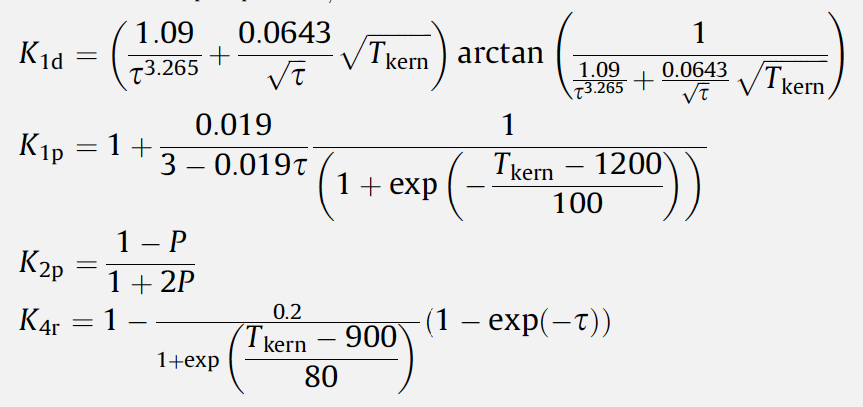

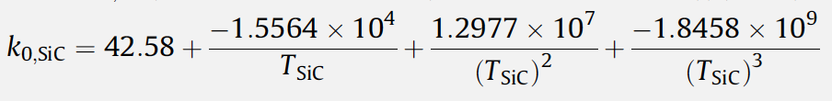
Material Evolution
Ideally, would be able to model and describe 3D modes of failure
Shrinkage cracks within the IPyC layer
IPyC/SiC debonding
Particle asphericity
Kernel migration
SiC coating thinning
Fission product attack

Slide 10
Data needs
There are a number of areas where we lack requisite data, either behavioral or fundamental properties, in order to accurately describe TRISO particle evolution
High-quality high burnup data on TRISO particles is generally lacking, which would enable benchmarking of fuel performance models
Uncertainties and unknowns in fundamental material properties are also abundant, especially with regard to how properties vary as functions of temperature, fast fluence, and burnup
There is significant uncertainty in the irradiation creep constant, the value of Poisson’s ratio in irradiation creep models, and the thermal conductivity of PyC
Predictions for the chemical attack of SiC require effective diffusion coefficients of key fission products in various fuel materials, which are unknown
Fuel properties are the least well understood, especially as the fuel evolves during operation

Slide 11
Material Performance in He

Slide 12
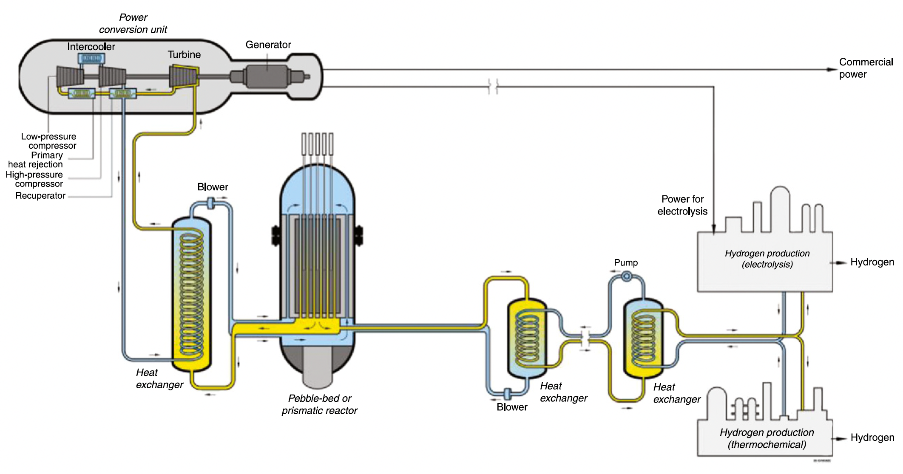
High Temperatures
Current designs target 750 C coolant outlet temperatures
Process heat requirements may require outlet temperatures up to 950C
The most critical metallic component in the VHTR system is the intermediate heat exchanger (IHX)
The high temperatures and long duration of operation restrict IHX material selection

Slide 13
Flow and Impurities
In the reactors under consideration, the gas pressure is typically between 5 and 7 MPa
The coolant is circulated at high velocity, sometimes over 100 m/s
Operating experience has shown that the primary He coolant tends to contain H2O, H2, N2, CO, CO2, and CH4 at concentrations of a few parts per million
These are the primary drivers of corrosion in He-cooled systems
Reactor systems need to have extensive gas cleanup systems associated with the helium coolant flow to keep the total impurity levels in the helium below typically 10 ppm
Active control should be maintained on the H2O and CO concentrations to reduce oxidation of the graphite
Molecular sieves are effective in capturing most of the gaseous impurities

Slide 14
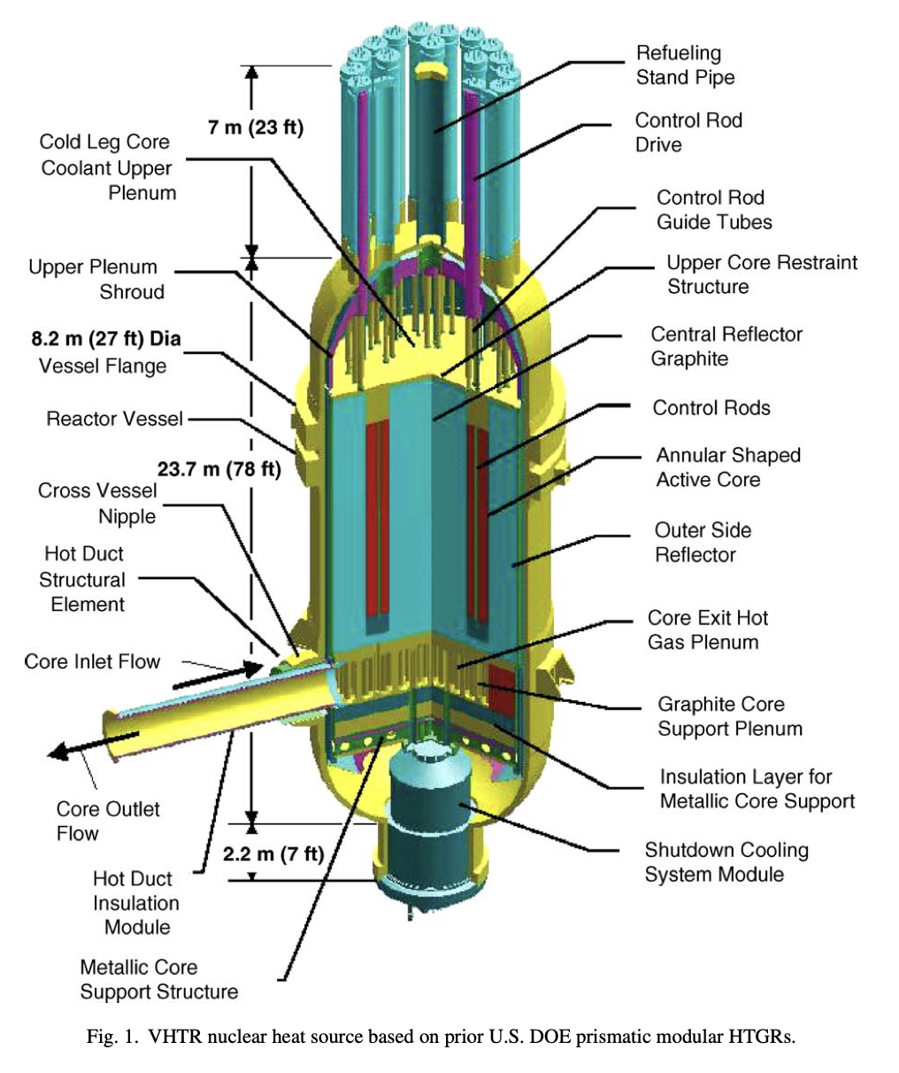
Reactor Pressure Vessels
The materials tentatively selected for reactor pressure vessel are low-alloy ferritic/martensitic steels, alloyed primarily with chromium and molybdenum, e.g., 2.25Cr-1Mo and 9Cr-1Mo
Both have been extensively used in fossil fuel industries
Temperatures expected to be up to 600 C for RPV, extending over 60 yr life
High temperatures and extended lifetime require additional qualification
Other main core internals are graphite

Slide 15
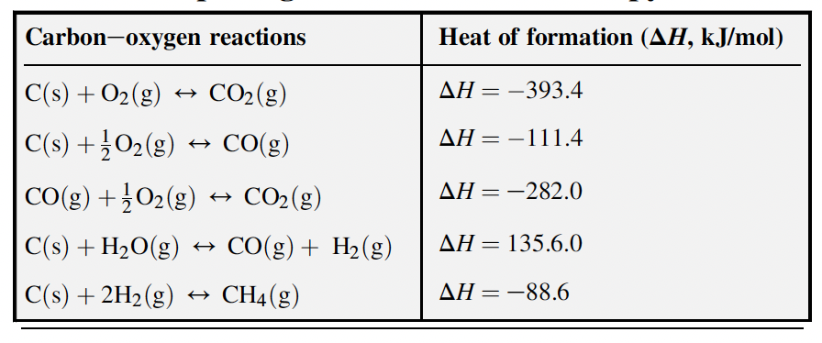
Graphite
Graphite and He play nice together, so we generally don’t worry about He corrosion
Oxygen control is key for considering potential graphite corrosion; occurs normally with impurities in the He and extensive corrosion can occur under a breach scenario
Primary gaseous oxidation product is CO, with gaseous CO2, H2, and CH4 produced in smaller quantities
Reaction of graphite with air becomes appreciable above 400 C

Slide 16
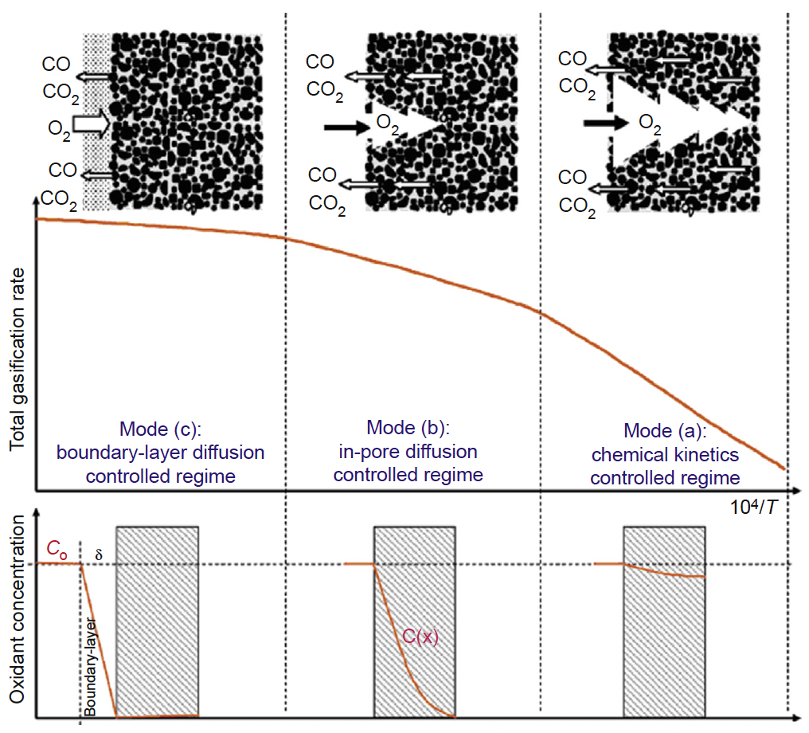
Graphite Oxidation Modes
A-Chemical regime: low T regime, reaction rate controlled by chemical reaction. Reaction occurs at all open surfaces throughout the bulk
B-In-pore diffusion regime: intermediate temperatures. Reaction rate occurs more quickly, and oxygen cannot be transported deeper in the bulk
C-Surface boundary layer regime: above 900C, mass transfer regime. Reactivity is so high that the oxygen is consumed at the surface without penetration to internal porosity

Slide 17
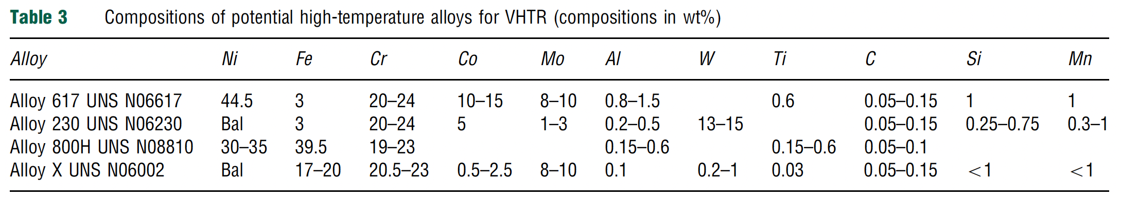
IHX Materials
Biggest area of concern for materials degradation
The desire for higher temperature operation led to selection of nickel-based alloys
These alloys rely on the formation of a chromia layer for long-term protection from environmental degradation
The alloys are primarily solid-solution strengthened with carbides on the grain boundaries to improve creep resistance

Slide 18

IHX Corrosion in VHTR
Extensive gas cleanup systems to keep impurities low, capture tritium, and prevent oxidation
Interplay between the alloy surface, temperature, and gas composition determines whether corrosive oxidation, carburization, or decarburization occur
Carburization is associated with low-temperature embrittlement, and decarburization is linked to reduced creep rupture strength
Ideally, a continuous self-healing, impermeable passivating oxide layer is needed to establish the most corrosion resistant alloy
There is a critical temperature above which the oxide layer is unstable, and CO production will occur

Slide 19
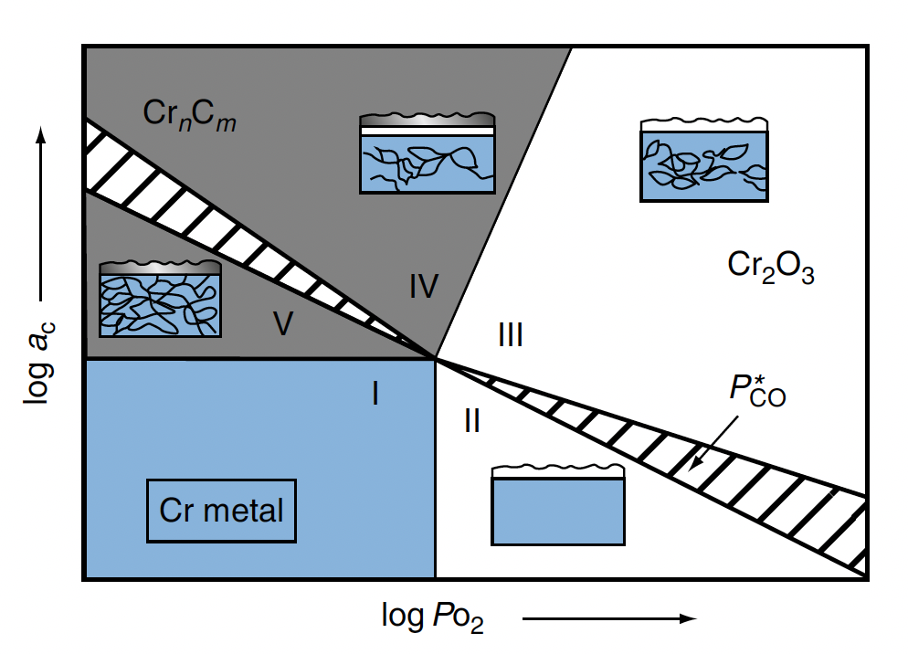
Alloy 617 Stability
Alloy 617 is the leading candidate for use in the VHTR heat exchangers because it has the highest creep strength of the solid-solution alloys under consideration for temperatures above 850C
Five conditions: I – strong reduction; II – decarburization; III – stable external oxide; IV – mixed surface oxide and carbide; and V – strong internal and external carburization
Zone 3 is optimal for stability

Slide 20
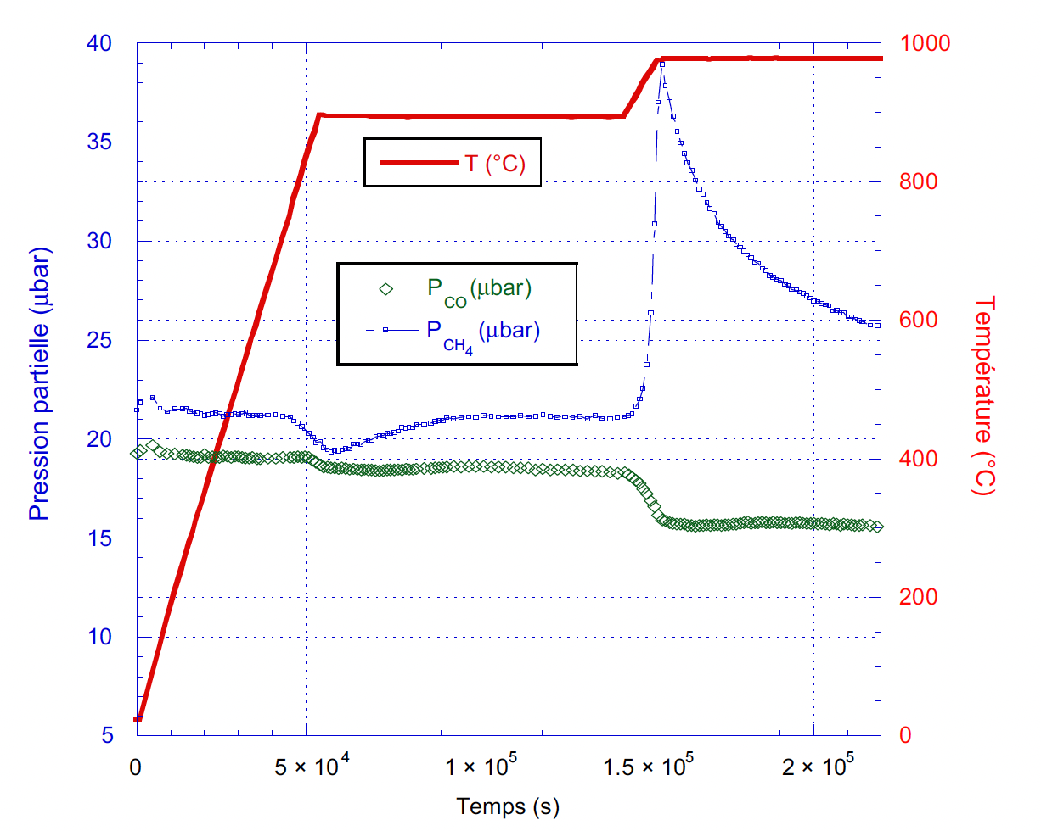
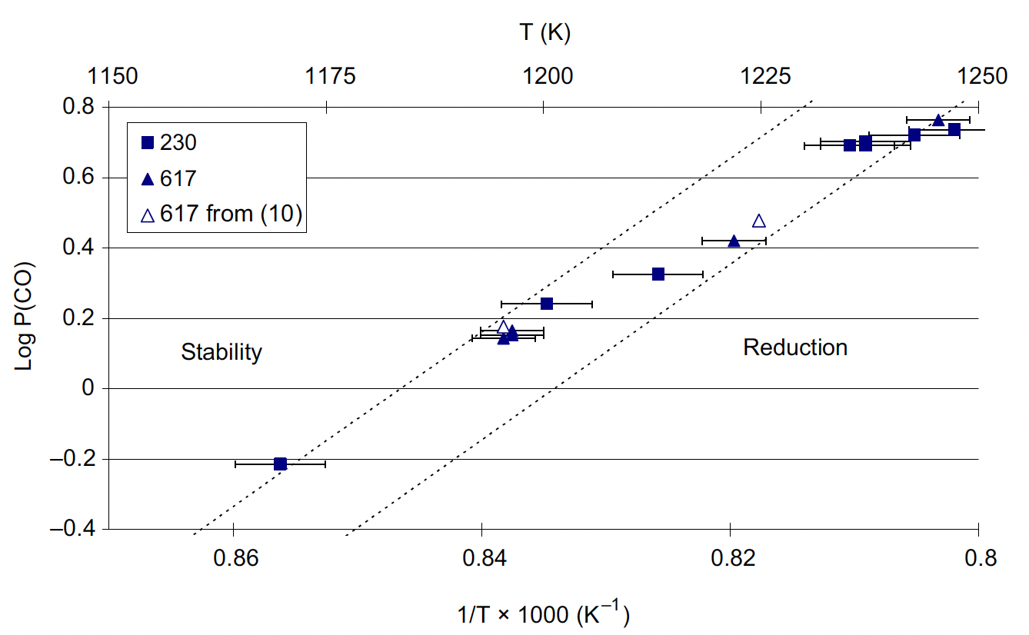
Surface Oxide Stability
Above a critical temperature, the surface oxide can be reduced, but that temperature is dependent upon the gas chemistry
Top right, surface oxide instability as evidenced from CO evolution
Bottom right, critical temp for oxide stability as a function of partial pressure of CO

Slide 21
He ‘Corrosion’ Summary
No IHX materials can withstand lifetime at 1000 C, but Alloy 617 is qualified up to 750 C, maybe be qualified up to 950 C
IHX want a stable oxide layer with stable internal carbides for strength and corrosion resistance; this is dependent upon the gas chemistry
Graphite will be oxidized if oxygen is present under operation, the rate and mode of oxidation are dependent upon the temperature
Helium isn’t the problem, but the impurities in He are, and thus cleanup/control systems are key
High temperatures and long lifetimes make corrosion+creep strength challenging

Slide 22
Fabrication

Slide 23
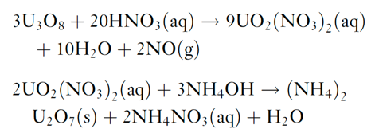
Fuel Kernel Fabrication
The sol–gel technique for kernel microsphere preparation is based on the following two chemical reactions starting from U3O8 powder
The (NH4)2U2O7 (ammonium di-uranate – ADU) is converted to UO2 by sintering in hydrogen gas
For the production of UCO kernels, carbon black is added to the broth and the sintering is performed in CO gas to ensure adequate C/O stoichiometry

Slide 24
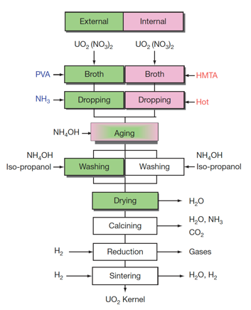
Fuel Kernel Fabrication
The mechanical strength of the coated layers depends on their thickness and sphericity, and thus strongly depend on the diameter and sphericity of the kernels
Vibrating nozzles from which droplets are emitted with high speed were developed for uniform and spherical kernel fabrication
A process is applied to prevent the deformation of droplets while they are landing on the ammonia water, where droplets are solidified while falling in ammonia gas blown against them

Slide 25
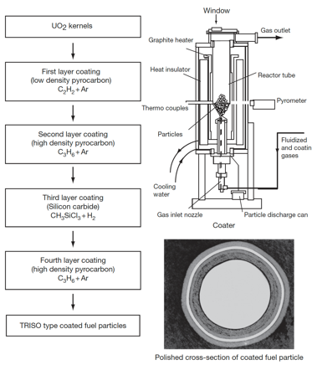
SiC (and PyC) Fabrication
The coating technology of both the SiC and PyC layers involves a fluidization of the kernel microsphere bed and chemical vapor deposition (CVD) coating
TRISO coating process is divided into four coating processes for the buffer, IPyC, SiC, and final OPyC layers
A specific mixture of gases is used for the deposition of each layer
buffer: C2H2+Ar; IPyC/OPyC: C3H6+Ar; SiC: CH3SiCl3+H2

Slide 26
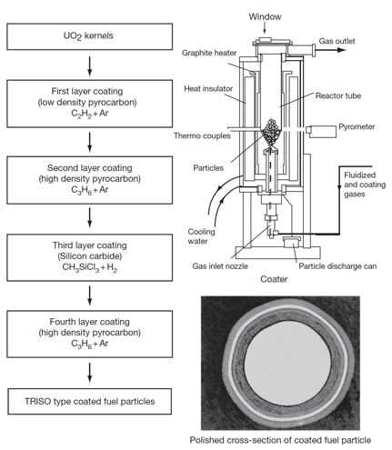
TRISO Fabrication
Rigorous control is applied at every step of the fabrication process to produce high-quality, very low-defect fuel
Defect levels are typically on the order of one defect per 100,000 particles
Specifications are placed on the diameters, thicknesses, and densities of the kernel and layers; the sphericity of the particle; the stoichiometry of the kernel; the isotropy of the carbon; and the acceptable defect levels for each layer

Slide 27
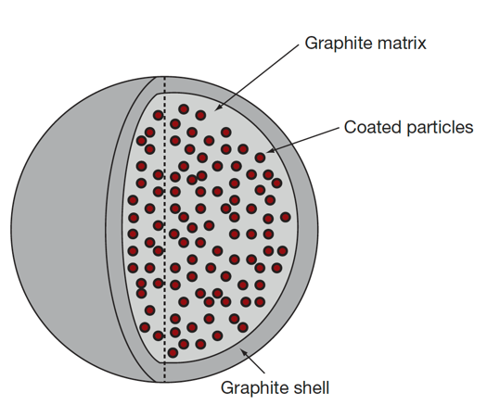
Pebble Fabrication
The fuel element of the pebble bed type HTGR is a spherical fuel element
The coated particles are overcoated with a layer of matrix graphite powder (MGP) and pressed to the core of a fuel sphere
Then, an additional 5-mm layer of matrix graphite material is added to form a ‘nonfuel’ zone
The resulting fuel sphere gets its final diameter by a machining process and is then carbonized and annealed at 2000C

Slide 28
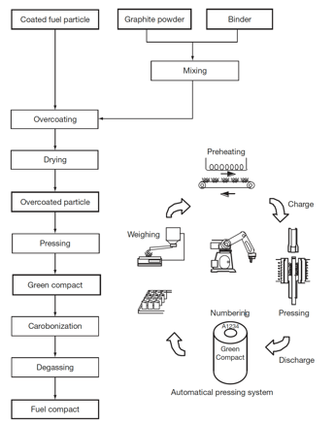
Compact Fabrication
HTGR fuel elements are graphite compacts stacked into a graphite core
To form compacts, coated fuel particles are overcoated with the MGP and warm-pressed to make the annular cylinder of green compacts
Green compacts are heat treated for carbonization at 800C and then sintered at 1800C to make fuel compacts
In order to decrease the failure fraction of coating layers, it is necessary to disperse coated fuel particles in a green compact as uniformly as possible

Slide 29
Summary
Sol-gel fabrication of fuel kernels
CVD for buffer, IPyC, SiC, and OPyC
Combine particles into compacts/pebbles with carbon matrix powder
Compacts/pebbles are then sintered to reach final state

